Slide 1
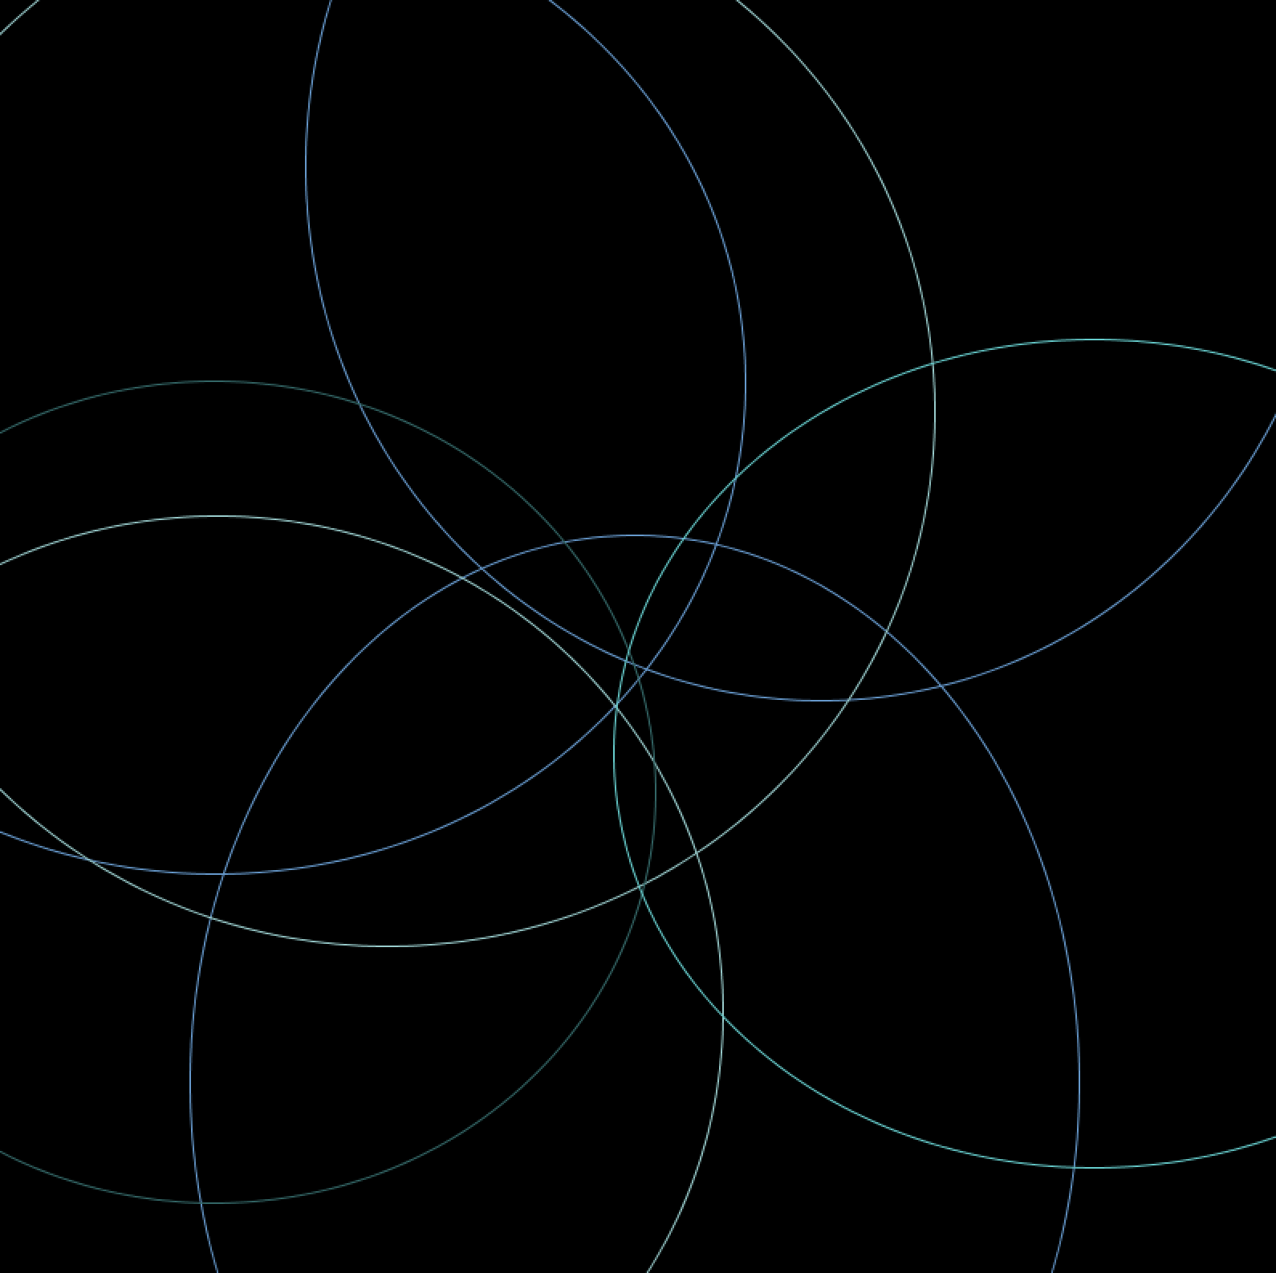
Data-Driven Generative Art Using processing.py
Allison G. Martínez-Arocho

Slide 2
About Me
Born and raised in Puerto Rico

Slide 3
About Me
Born and raised in Puerto Rico
B.S. Computer Science

Slide 4
About Me
Born and raised in Puerto Rico
B.S. Computer Science
Software Engineer at IBM

Slide 5
About Me
Born and raised in Puerto Rico
B.S. Computer Science
Software Engineer at IBM
I like cats

Slide 6
About Me
Born and raised in Puerto Rico
B.S. Computer Science
Software Engineer at IBM
I like cats
Notorious for telling bad jokes
Notes:
Show of Hands, yo

Slide 7
Generative Art
… is any art practice where the artist creates a process, which is then set into motion with some degree of autonomy contributing to or resulting in a completed work of art.

Slide 8
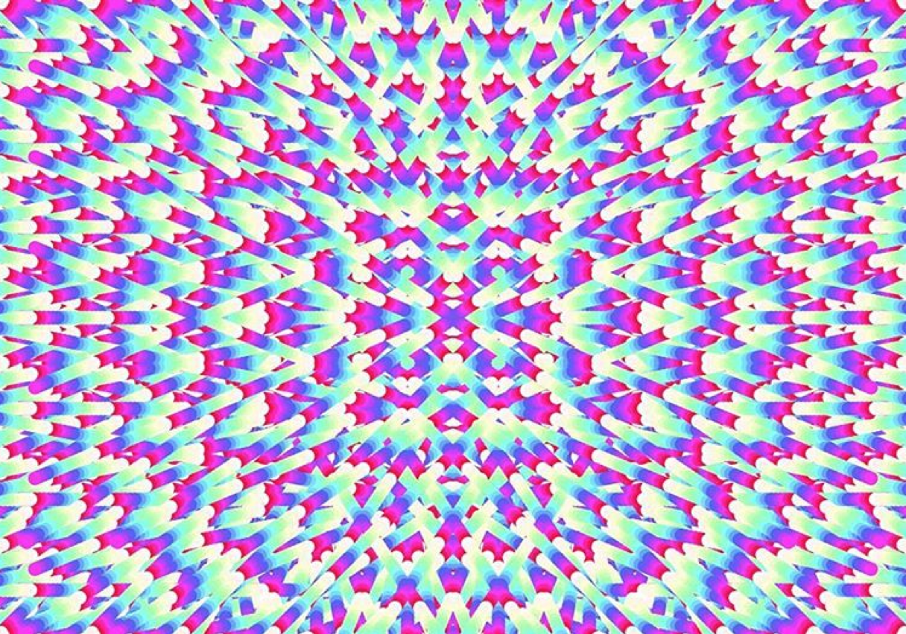
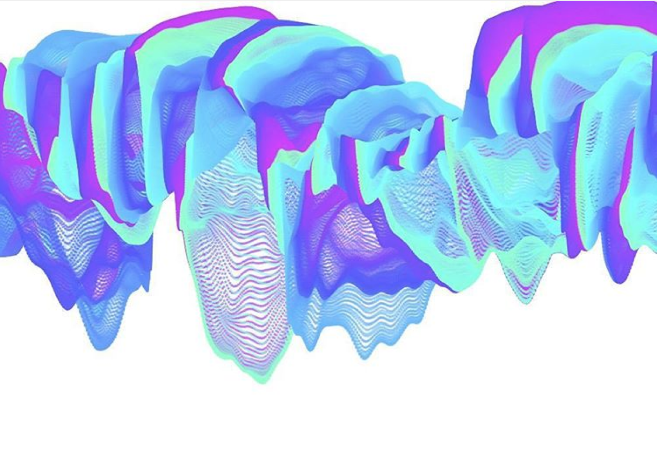
Generative Art
… is any art practice where the artist creates a process, which is then set into motion with some degree of autonomy contributing to or resulting in a completed work of art.
-Philip Galanter
Art by Irena Rindos

Slide 9
Data-Driven Generative Art
Art that is created with processes that are informed by data

Slide 10
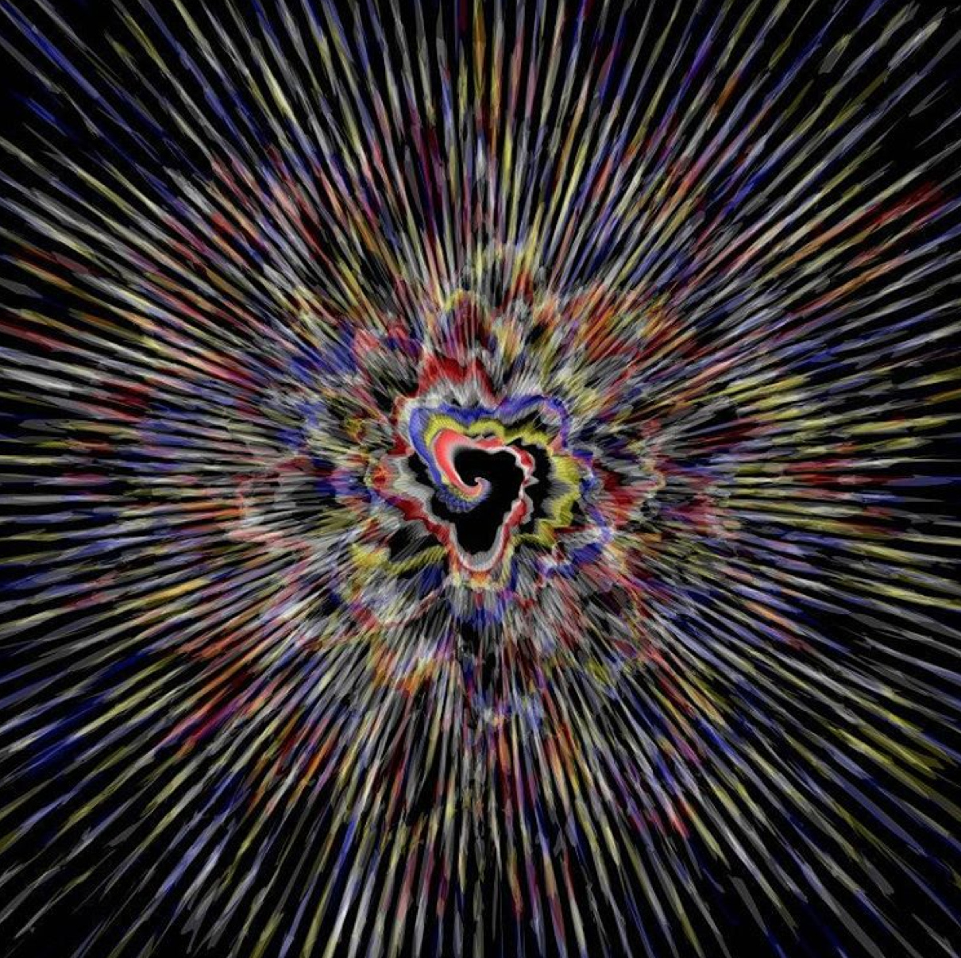
Data-Driven Generative Art
Art that is created with processes that are informed by data
Art by Irena Rindos

Slide 11

Processing (processing.org)
Programming language, and development environment

Slide 12
Processing (processing.org)
Programming language, and development environment
Has promoted software literacy within the visual arts and visual literacy within technology
Notes:
Originally released with a Java-based syntax
Now has several alternative programming interfaces: Python, JS, Ruby

Slide 13
APIs in a nutshell… a very small nutshell
Client HTTP GET
Server /data/bayamon (REST API)
forecast/[key]/[Lat],[Long]
Request
JSON Forecast Object
Response
Today’s data: https://darksky.net/dev/docs
About APIs: https://www.codecademy.com/apis
Notes:
Take advantage of HTTP methodologies:
GET, PUT, POST, DELETE
For today, we only need to understand:
GET requests, which are used to retrieve resources

Slide 14
Let’s get ready to make art!
Go to: https://github.com/arocho/generative-art
Or go to the PyCaribbean Slack #gen-art channel
Install Processing, and open the pc_ws.pyde file

Slide 15

Modify, and make it your own
Look for different colors: (color-hex.com)
Use different shapes: ellipse(), rect(), triangle()
Change the widths and height of your shapes
SHARE!

Slide 16
Questions?
THANKS A BUNCH!
Allison G. Martínez Arocho
linkedin.com/in/allisonarocho
alli.arocho@gmail.com
@vamoavel

